Slide 1
Chapter 3
Finite Difference Methods and Interpolation

Slide 2
Finite Differences
Numerical technique that lends itself to the numerical solution of large sets of simultaneous differential equations that lack analytical solutions.
Need to develop the systematic terminology used in the calculus of finite differences.
Finite differences also find application in the derivation of interpolating polynomials.

Slide 3
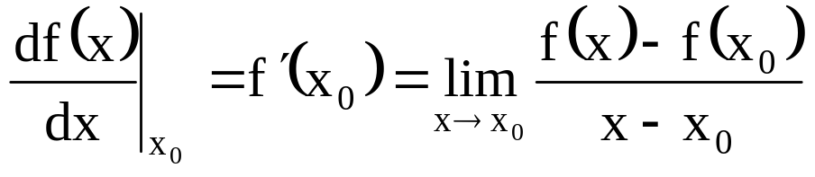
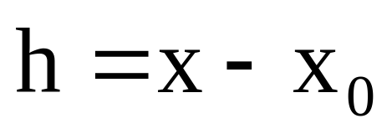
Symbolic Operators
Definition of the derivative
In the calculus of finite differences, x - x₀ does not approach zero, but remains finite; and is represented by the quantity h.

Slide 4
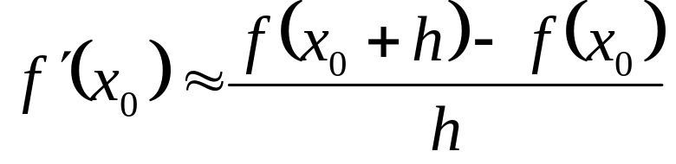
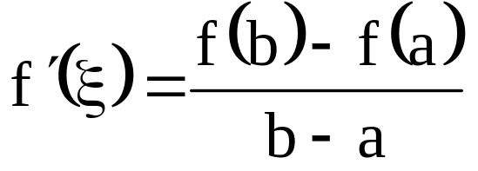
Symbolic Operators
The derivative may therefore be approximated:
Mean Value Theorem states "Let f(x) be continuous in a ≤x≤b, and differentiable in the range a<x<b; then there exists at least one ξ, a<ξ<b for which
The Mean Value Theorem forms the basis for both differential and finite difference calculus

Slide 5
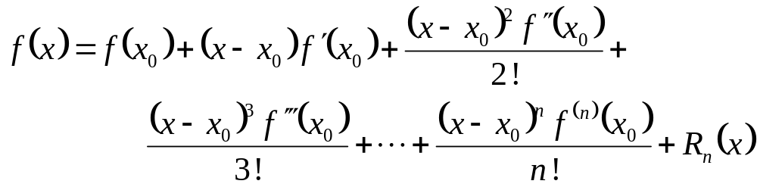
Symbolic Operators
A function f(x) continuous and differentiable in the interval [x₀, x] can be represented by Taylor series:
R_{n} includes terms from (n+1) to ∞ (i.e, truncation error)

Slide 6
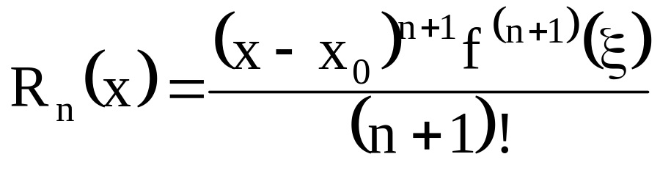
Symbolic Operators
MVT can be used to show that a point ξ exists in the interval [x₀, x] such that:
Remainder is of the order (n+1) because it is a function of a term (x-x₀)^{n+1} and the (n+1)^{th} derivative → O(n^{n+1})

Slide 7
Linear Symbolic Operators
Operator | Definition
D | differential
I | integral
E | shift
Δ | forward difference
∇ | backward difference
δ | center difference
µ | average

Slide 8
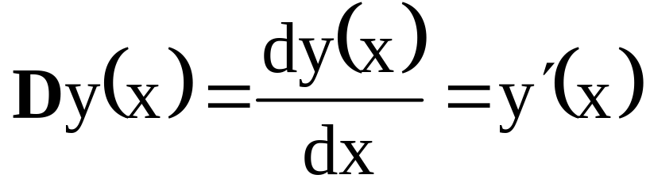
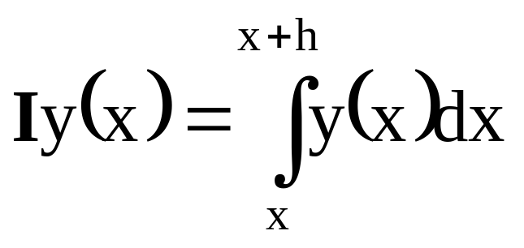
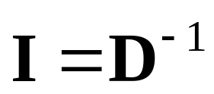
Linear Symbolic Operators
Differential Operator, D
Integral Operator, I

Slide 9
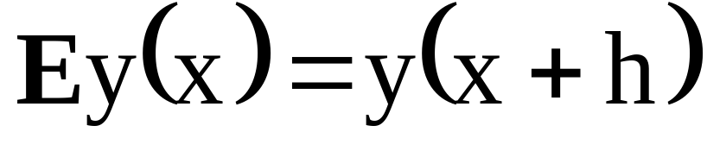
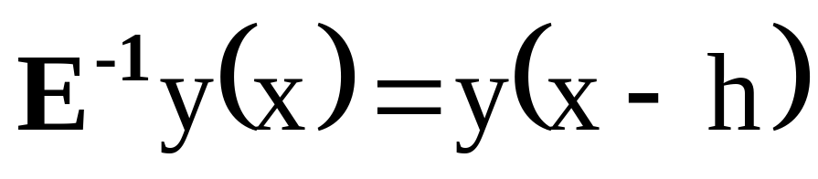
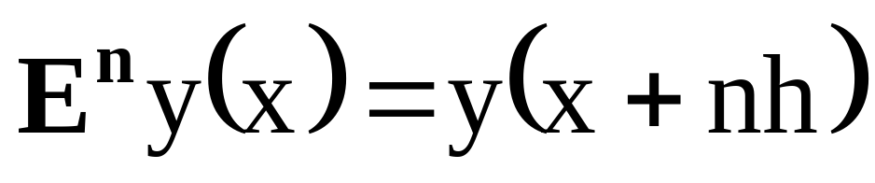
Linear Symbolic Operators
Shift Operator, E

Slide 10
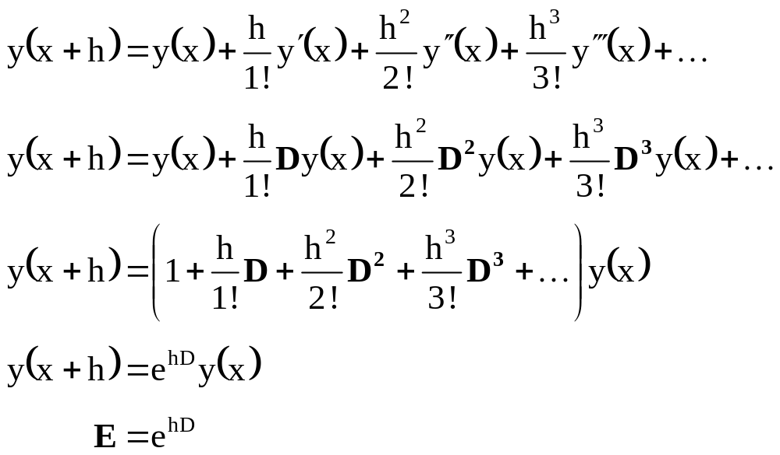

Linear Symbolic Operators
Express shift operator in terms of differential operator by expanding y(x+h) into a Taylor series:
Content of parantheses is Taylor series expansion of e^{hD}.
compare to definition…

Slide 11
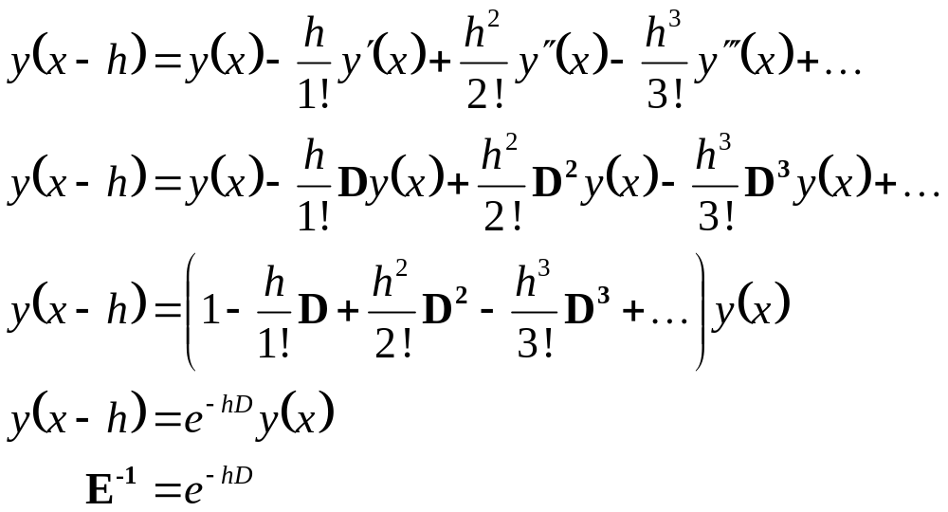
Linear Symbolic Operators
Inverse of shift in terms of differential operator :
Content of parantheses is Taylor series expansion of e^{-hD}.

Slide 12
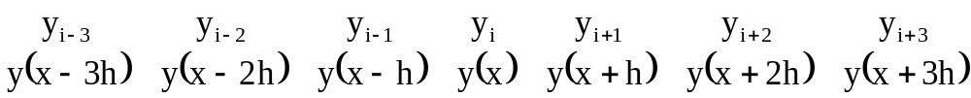
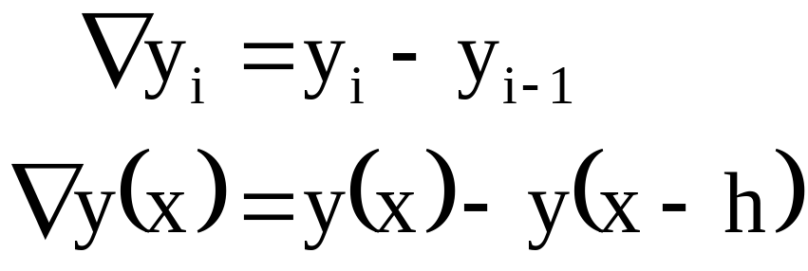
Backward Finite Difference (BFD)
Consider the equivalent sets of values:
The first backward finite difference of y at i is defined:

Slide 13
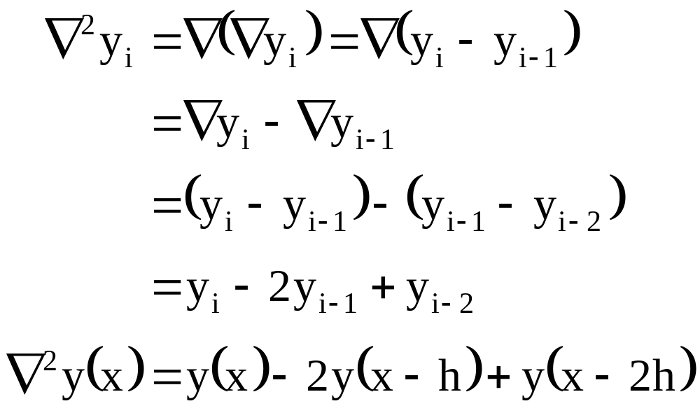
Backward Finite Difference
The second backward finite difference:

Slide 14
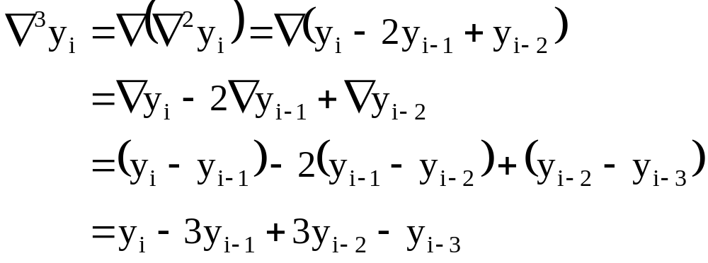
Backward Finite Difference
The third backward finite difference:

Slide 15
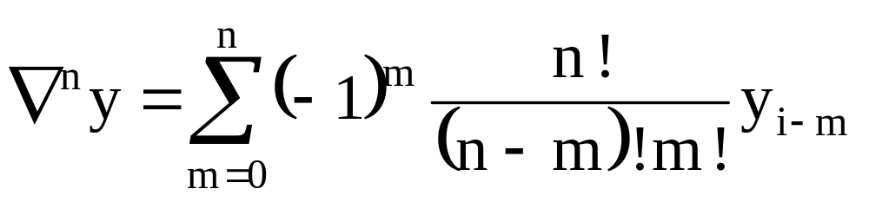
Backward Finite Difference
The n^{th} backward finite difference:

Slide 16
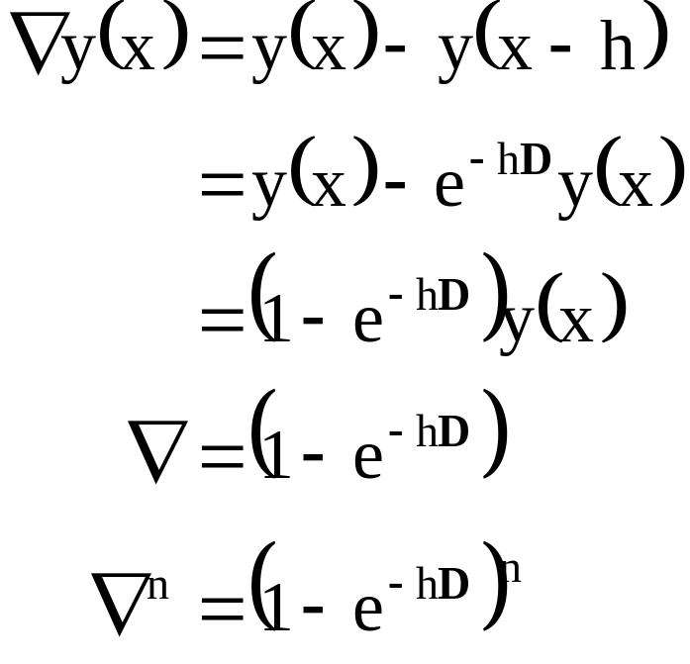
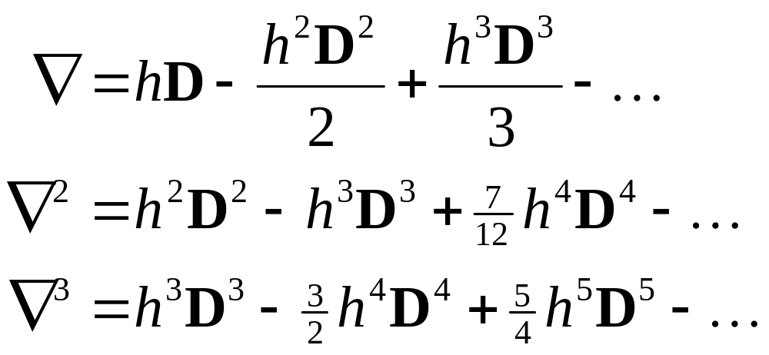
Backward Finite Difference
Establish relationship between backwards difference operators and differential operators (i.e, ∇=f(D)):

Slide 17
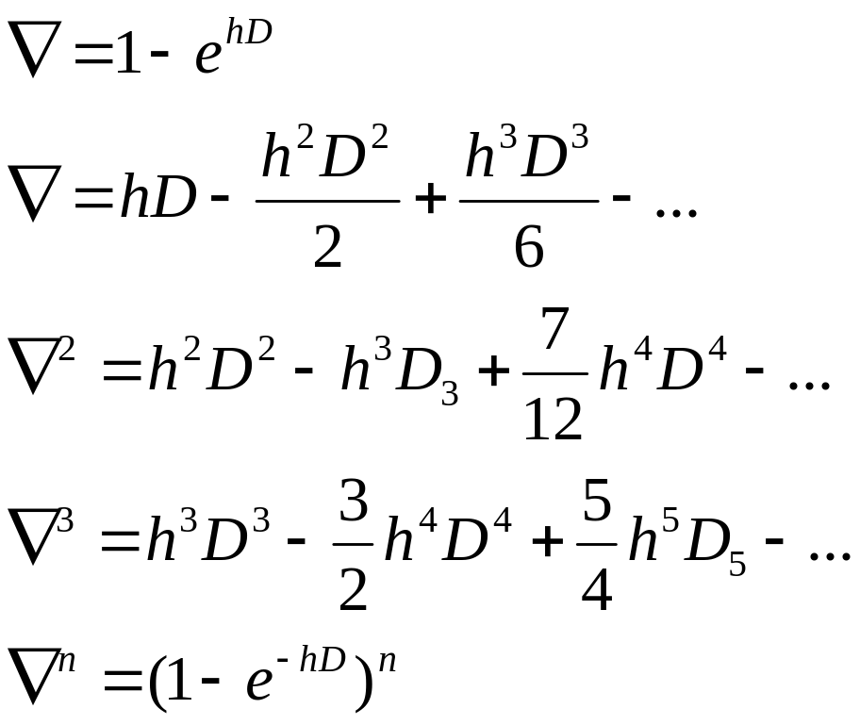
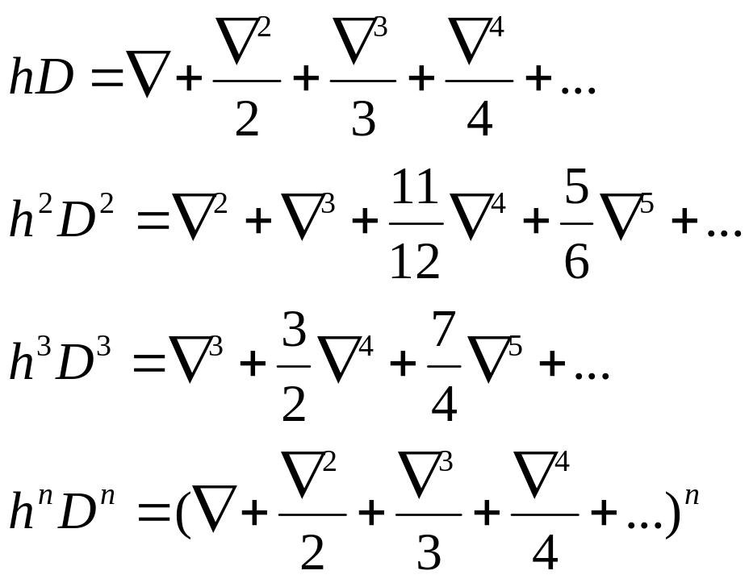
Relate ∇ to D

Slide 18
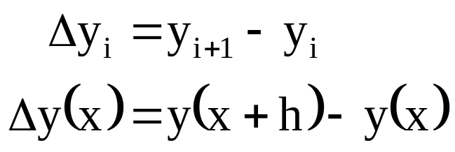
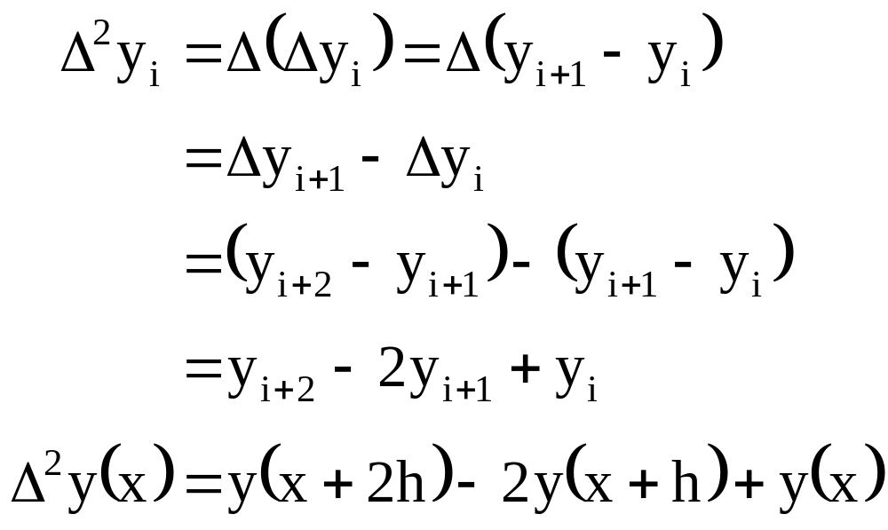
Forward Finite Difference (FFD)
The first forward
finite difference:
The second
backward
finite difference

Slide 19
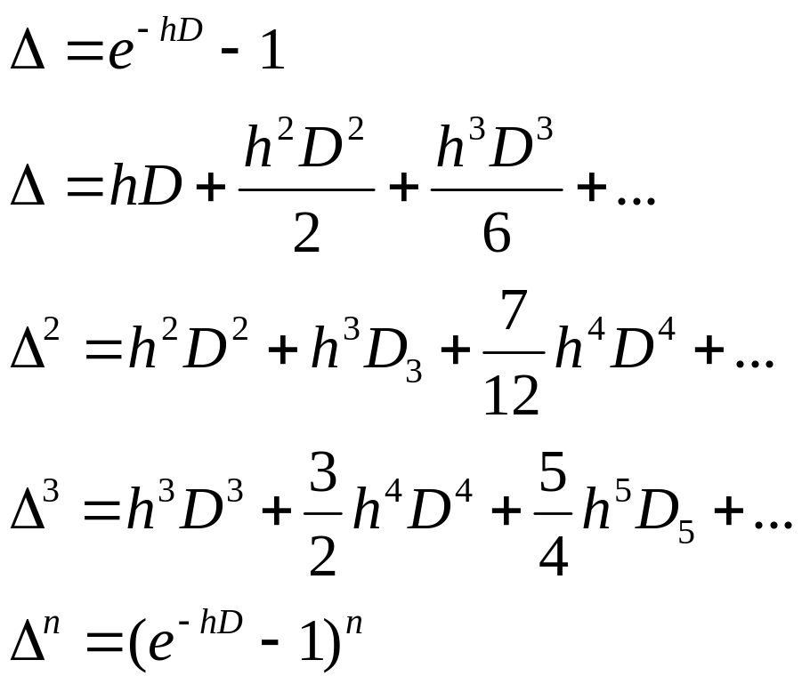
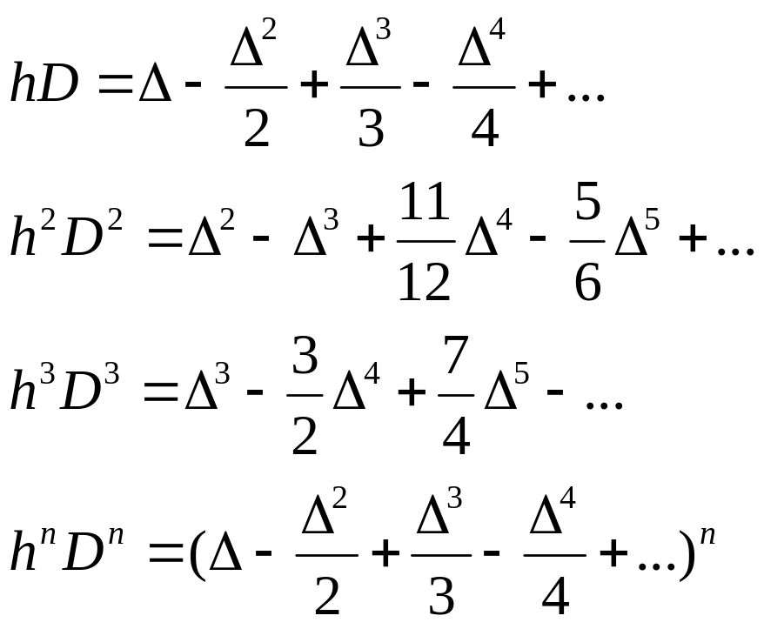
Relate Δ to D

Slide 20
Central Finite Difference (CFD)
Consider the equivalent sets of values:

Slide 21
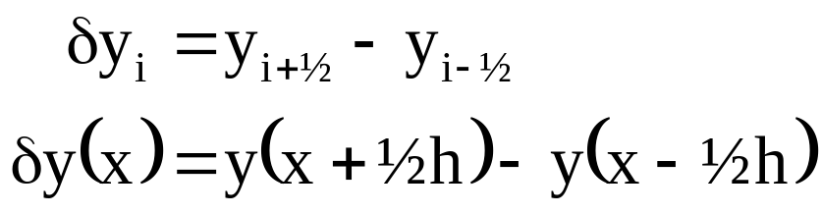
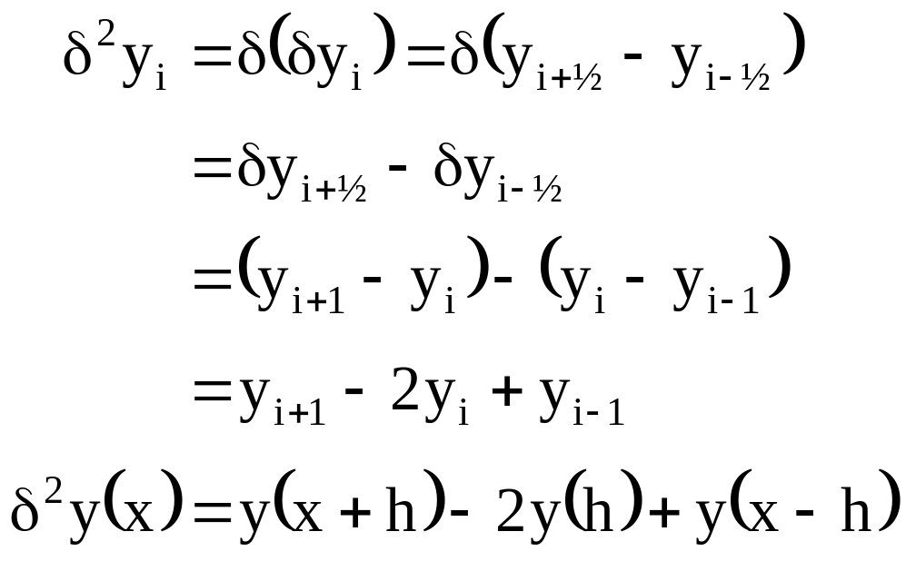
Central Finite Difference
The first central
finite difference:
The second
central
finite difference

Slide 22
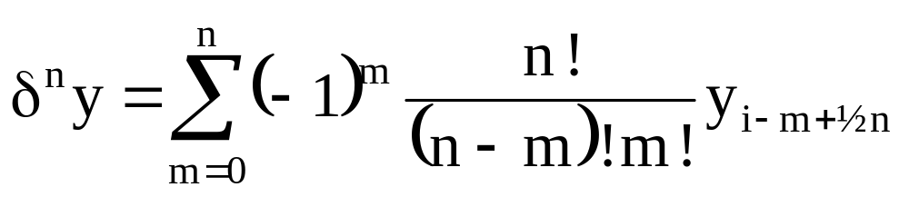
Central Finite Difference
The n^{th} forward finite difference:
  Odd order → interval midpoints
  Even order → interval endpoints
  ∴ twice the number of points necessary to use CFD

Slide 23
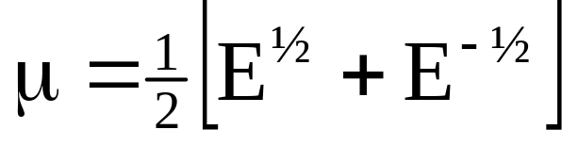
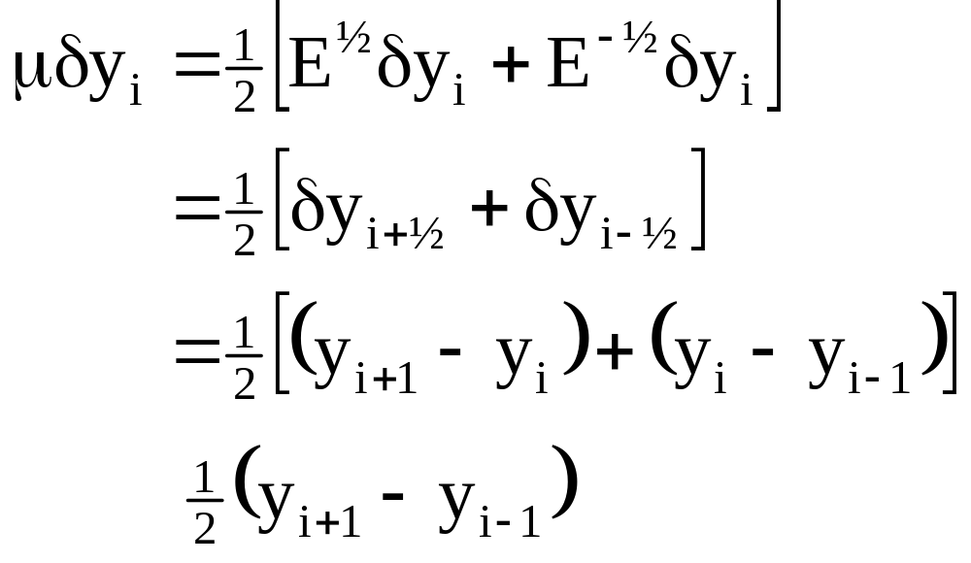
Central Finite Difference
Define average operator, μ:
  Shifts operand ½ interval left(+) or right(-) of the pivot, averaging the evaluations at each

Slide 24
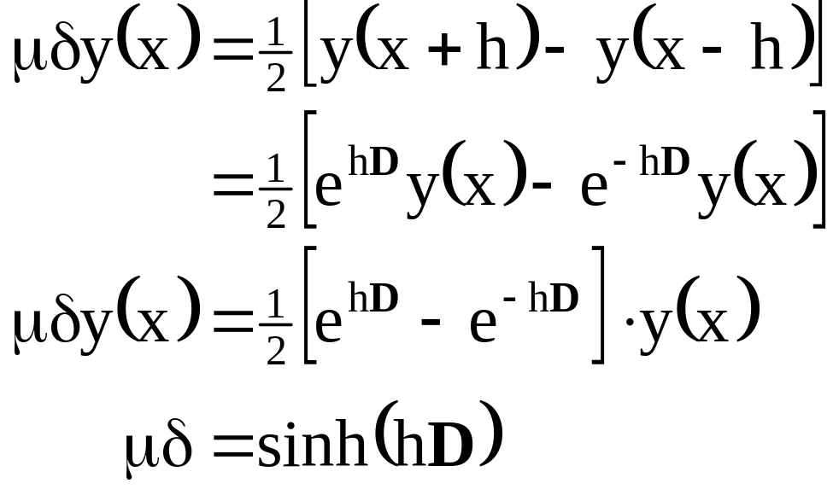
Relate δ to D
First averaged central difference

Slide 25
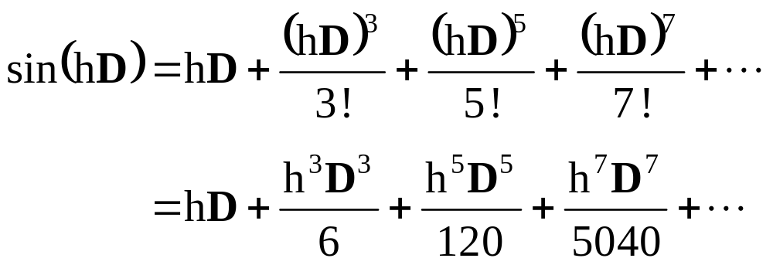
Relate δ to D
Expand in Taylor Series:

Slide 26
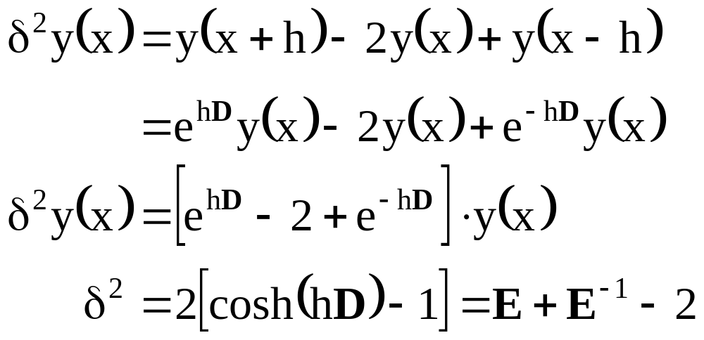
Relate δ to D
Second central difference

Slide 27
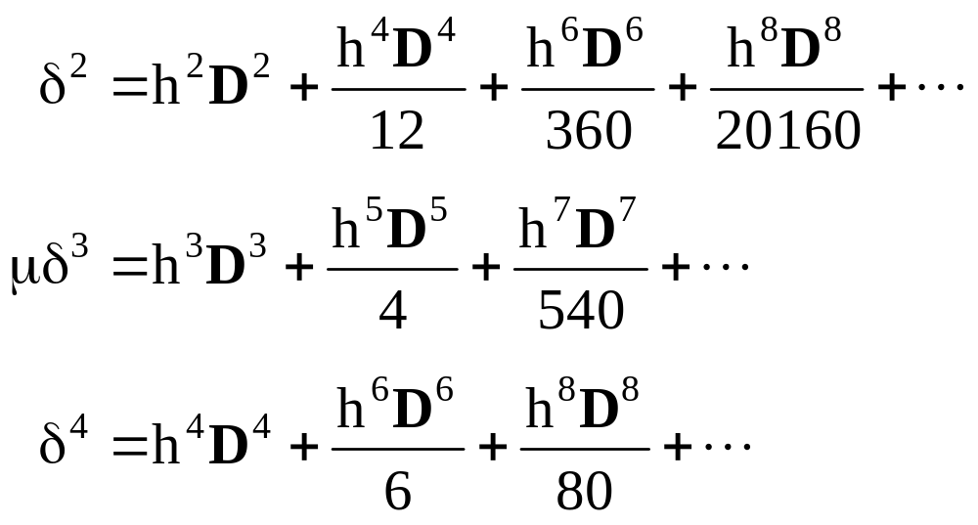
Relate δ to D
Expand in Taylor Series (and by analogy, expand to higher order Central Finite Difference terms):

Slide 28
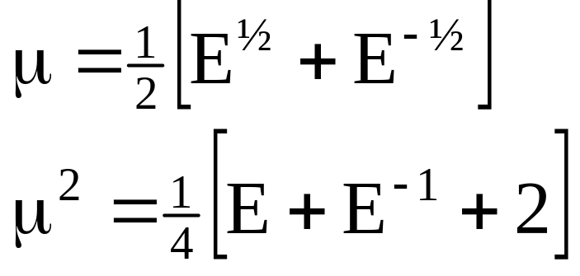
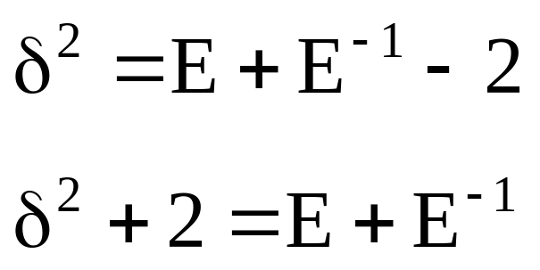
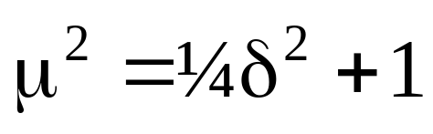
Relate δ to μ
Start with definitions of μ and δ:

Slide 29
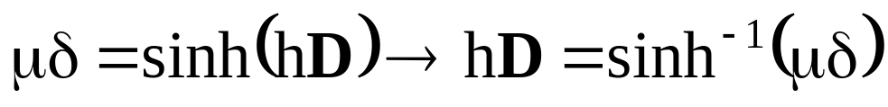
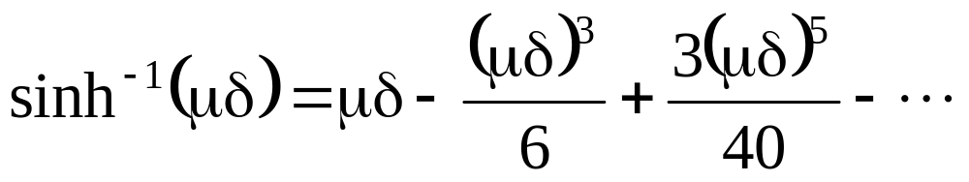
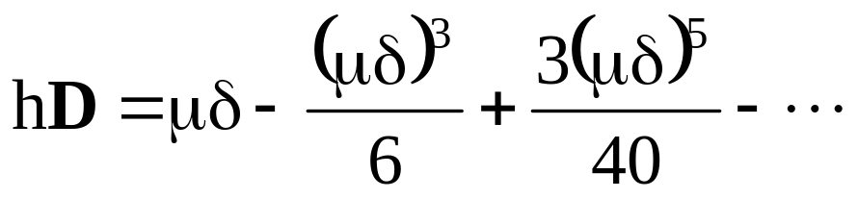
Relate δ to μ
Recall:
Expand inverse sine argument:
Substitute:

Slide 30
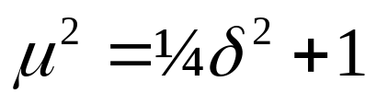
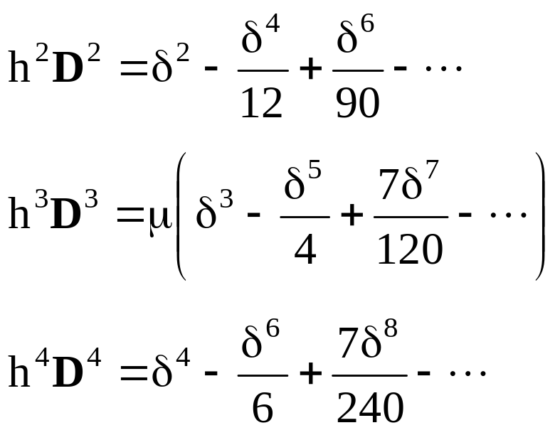
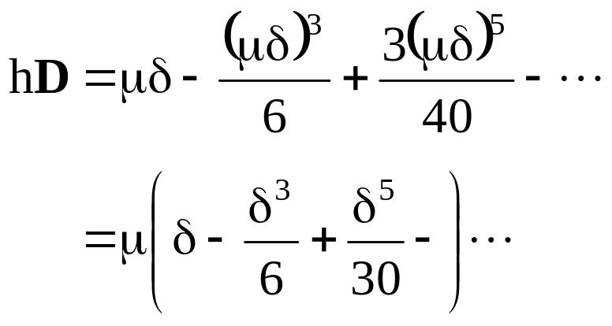
Relate δ to μ
Using the result →
eliminate even powers to obtain hD, or higher orders

Slide 31
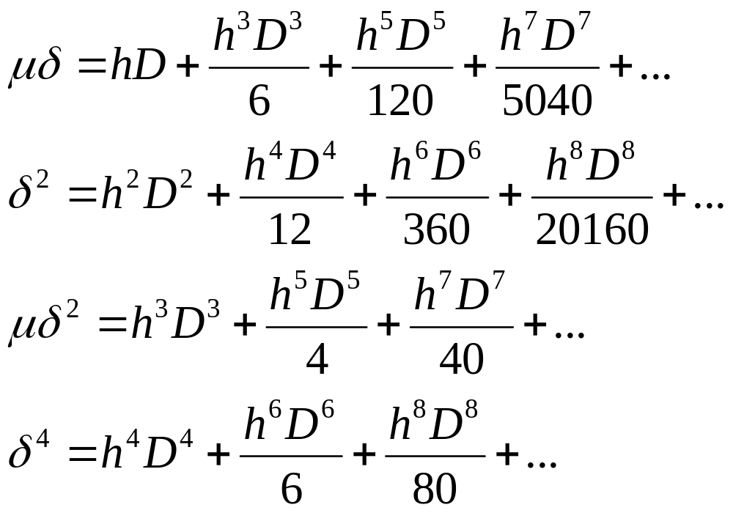
Relate µδ to D

Slide 32
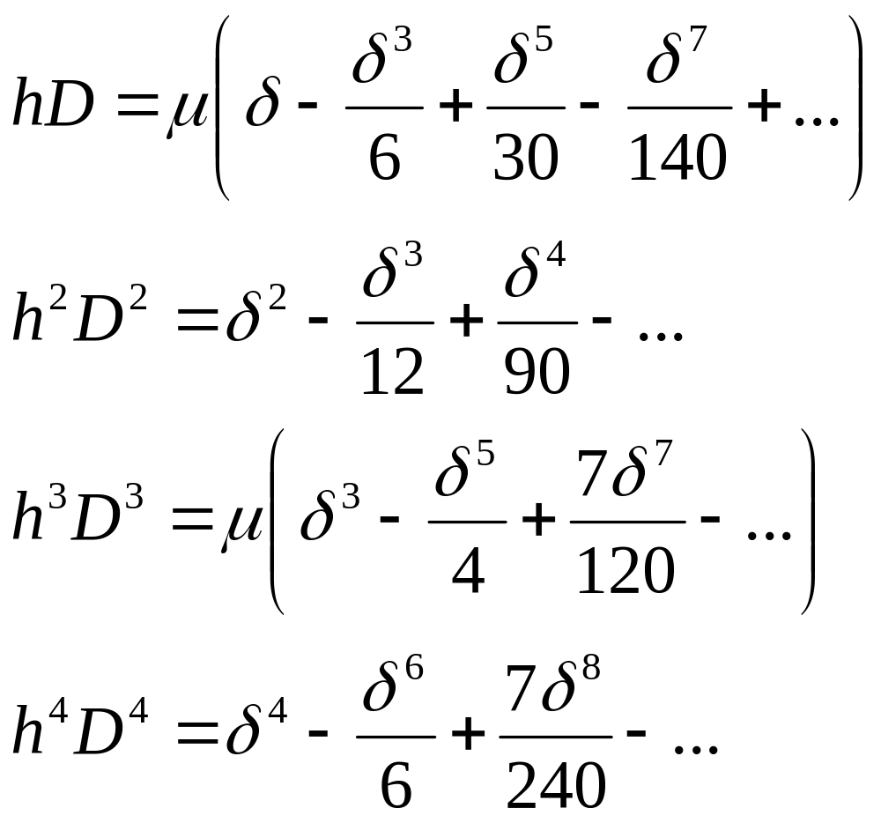
Relate µδ to D

Slide 33
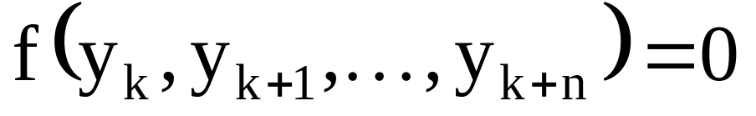
Difference Equations and Solution
Forward, backward, and central FD equations are used in the solution of differential equations.
FDs transform differential equations into difference equations:
  Eqns may be linear/nonlinear, may be homogeneous/non, and may have constant or variable coefficients
  We will focus on linear, homogeneous systems with constant coefficients

Slide 34

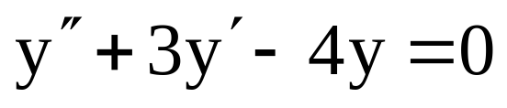
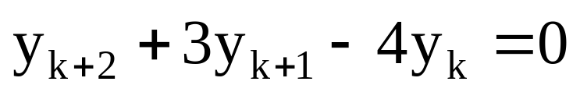
Order of a Difference Equation
The order of a difference equation is the difference between the highest and lowest subscript of the dependent variable:
order = (k+n)-k=n
2nd order homogeneous linear ordinary differential equation
2nd order homogeneous linear difference equation

Slide 35

Solution of a Differential Equation
Characteristic equation
Eigen values

Slide 36




Solution of a Difference Equation
real & distinct roots
real & repeated roots
two complex roots

Slide 37

Difference Equation Solution Forms
Solution is of the form:
  k is the marching counter
  λ is a Eigen values of the characteristic equation

Slide 38




Difference Equation Solution Forms
real & distinct roots
real & repeated roots
two complex roots
polar form

Slide 39
Stability/Convergence Depend on λ
Stable, converging with oscillations
  λ → real, distinct, and | λ | ≤ 1
  λ → real, repeated, and | λ | < 1
Stable, converging with damped oscillation
  λ → complex (α±βi), distinct, and | r | ≤ 1
  λ → complex, repeated, and | r | < 1
Unstable, non-oscillatory
  λ → real, distinct, and | λ | > 1
  λ → real, repeated, and | λ | ≥ 1
Unstable, oscillatory
  λ → complex (α±βi), distinct, and | r | > 1
  λ → complex, repeated, and | r | ≥ 1

Slide 40


Stability/Convergence Depend on λ
Stable, converging with oscillations
  λ → real, distinct, and | λ | ≤ 1; λ → real, repeated, and | λ | < 1

Slide 41


Stability/Convergence Depend on λ
3. Unstable, non-oscillatory
  λ → real, distinct, and | λ | > 1 λ → real, repeated, and | λ | ≥ 1

Slide 42

Stability/Convergence Depend on λ
4. Unstable, oscillatory
  λ → complex (α±βi), distinct, and | r | = 1

Slide 43

Stability/Convergence Depend on λ
4. Unstable, oscillatory
  λ → complex (α±βi), distinct, and | r | > 1

Slide 44
Interpolation
Interpolation is a process of finding a formula (often a polynomial) whose graph will pass through a given set of points (x, y).
As an example, consider defining:
x₀ = 0, x₁ =π/4, x₂ = π/2
and
y_{i} = cosx_{i}, i= 0, 1, 2

Slide 45

Interpolation

Slide 46

Interpolation

Slide 47
Interpolation
PURPOSES OF INTERPOLATION
Replace a set of data points {(xi, yi)} with a function given analytically.
2. Approximate functions with simpler ones, usually polynomials or ‘piecewise polynomials’.

Slide 48

Interpolation
Purpose #1 has several aspects.

Slide 49

Interpolation

Slide 50

Interpolation

Slide 51
Interpolation
Purpose #2 for interpolation is to approximate functions f(x) by simpler functions p(x), perhaps to make it easier to integrate or differentiate f(x). That will be the primary reason for studying interpolation in this course.

Slide 52

Interpolation

Slide 53

Linear Interpolation

Slide 54

Interpolation

Slide 55

Linear Interpolation

Slide 56

Linear Interpolation

Slide 57
Linear Interpolation
The true value is tan(1.15) = 2.2345. We will want to examine formulas for the error in interpolation, to know when we have sufficient accuracy in our interpolant.

Slide 58

Linear Interpolation

Slide 59

Quadratic Interpolation

Slide 60

Quadratic Interpolation

Slide 61

Quadratic Interpolation

Slide 62
Quadratic Interpolation
for i, j = 0, 1, 2. Also, they all have degree 2. As a consequence of each L_{i}(x) being of degree 2, we
have that the interpolant:
P₂(x) = y₀L₀(x) + y₁L₁(x) + y₂L₂(x)
must have degree ≤ 2.

Slide 63

Higher Degree Interpolation

Slide 64

Higher Degree Interpolation

Slide 65

Higher Degree Interpolation

Slide 66

Higher Degree Interpolation

Slide 67
Higher Degree Interpolation
It improves with increasing degree n, but not at a very rapid rate. In fact, the error becomes worse when n is increased further. Later we will see that interpolation of a much higher degree, say n ≥ 10, is often poorly behaved when the node points {x_{i}} are evenly spaced.

Slide 68


Interpolating Polynomials
Useful in representing experimental data when fundamental relationship is not known.
Chose form of polynomial:
for the base points, it must be true that
Substitute n known x_{n} and f(x_{n}) values into
P_{n}(x), yields n+1 simultaneous linear algebraic
equations with unknown coefficients a₀ – a_{n}.
base points
of function

Slide 69




Gregory-Newton Interpolation
Consider a set of known values of f(x) at equally spaced values of x (base points):
apply FFD
recall
thus
expand as binomial series

Slide 70
Gregory-Newton Interpolation
Substitute expansion
  if n = positive integer, series has n+1 terms
  therefore, expansion is a polynomial of degree n
  if n+1 base points are known, expansion fits all n+1 points exactly

Slide 71

Gregory-Newton Interpolation
Define interval size as x_{i} = x₀ + nh, solve for n and substitute
Generalized as:
binomial series has a finite number of terms when n is a positive integer. However, in Gregory-Newton, n is not usually an integer, therefore the series has an infinite number of terms.
If |Δ| ≤ 1, binomial series for (1+Δ)^{n} converges to (1+Δ)^{n} when the number of terms gets increasingly larger (implies FDs must be small)

Slide 72


Stirling's Interpolation
Based on central differences (see text for development)
Generalized formulae for higher-order terms includes expressions for both odd differences and even differences:

Slide 73



Lagrange Polynomials
Unequally spaced point interpolation
Based on polynomial defined as:
  p_{k}(x) are nth degree polynomial functions corresponding to each base point
  each weighting function polynomial p_{k}(x) must be chose so that it has the value of unity when x = x_{k}, and zero at all other base points
selection criteria
function form

Slide 74

Lagrange Polynomials
Constants C_{k} are evaluated to make the second criteria true (p_{k}(x) = 1 @ i = k):
selection criteria
function form

Slide 75


Lagrange Polynomials
Combine to yield Lagrange Interpolating Polynomials:
With remainder term

Slide 76

Spline Interpolation
When dealing with a large number of data points, a high degree polynomial is likely to fluctuate between base points, rather than pass smoothly through the points.

Slide 77
Spline Interpolation
Spline interpolation is designed to correct this behavior through a series of lower-degree interpolating polynomials in the vicinity of each base point.
Most common → cubic spline

Slide 78

Cubic Spline
On the interval [x_{i-1}, x],
There are 4 unknowns in each P_{i}, and n P_{i}'s on the interval [x₀, x_{n}]
∴ the 4n unknown coefficients require 4n equations to determine.

Slide 79
Required Cubic Spline Equations
  Each spline passes from the base points on the edge of its interval (2n eqns)
  First derivatives of the splines are continuous across the interior base points (n-1 eqns)
  Second derivatives of the splines are continuous across the interior base points (n-1 eqns)
  Second derivatives of the end splines are zero at the end base points (2 eqns, natural condition) or
  Third derivatives of the end splines equal to the third derivative of the neighboring spline (not-a-knot condition)

Slide 80

Cubic Spline
Define cubic spline equation and derivatives:

Slide 81


Cubic Spline
2nd derivative of interpolating polynomial at any point [xi-1, xi] can be given by the 1st order LaGrange interpolation polynomial:
Which can be integrated twice as:

Slide 82






Cubic Spline
integration constants from BCs
Which is equivalent to with
Eq. 1

Slide 83

Cubic Spline
Unknowns y"_{i-1} and y"_{i} are determined from continuity of the first derivative of the spline at interior base points, i.e., y'_{i-1} = y'_{i}.
Differentiating Eq.1, and applying continuity
Which is an (n-1)^{th} order tridiagonal matrix

Slide 84


Cubic Spline in Matrix Form
or
which we
already know
how to solve

Slide 85

Orthogonal Polynomials
Satisfy orthogonality condition with respect to a weighting function w(x) ≥ 0:
Families of polynomials can be defined that obey such a condition, named after their creators (inventors, discoverors,…).

Slide 86


Legendre Polynomials
The simplest of the orthogonal class:

Slide 87



Legendre Polynomials
Satisfies recurrence:

Slide 88




Chebyshev Polynomials
Satisfies recurrence:

